Slide 1
Interaksi Manusia dan Komputer (IMK)
THE USER INTERFACE (UI) DESIGN PROCESS
Step - 8
Clear Text and Messages
Step - 9 Provide Effective Feedback and Guidance and Assistance

Slide 2
Interaksi Manusia dan Komputer (IMK)
THE USER INTERFACE (UI) DESIGN PROCESS
Step - 8
Clear Text and Messages

Slide 3
Tujuan
Setelah mengikuti materi ini mahasiswa dapat:
Mahasiswa/i mampu merancang teks dan pesan yang tepat dan sesuai dengan prinsip UI

Slide 4
Outline (Step 8)
Panduan dalam penulisan teks dan pesan
General :
The concept of readability.
Choosing the proper words.
Writing sentences and messages.
Kinds of messages.
Presenting and writing text.
Window title, conventions, and sequence control guidance
Web Spesific Guidelines :
Presenting and writing page text.
Writing links and headings.
Writing instructions and error messages

Slide 5
Outline (Step 8)
Contoh penulisan teks
Feedback
Guidance & Assitance
Contoh kasus feedback
Contoh kasus Guidance dan Assistance

Slide 6
Outline (Step 9)
Feedback
Guidance & Assistance
Contoh kasus Feedback
Contoh kasus Guidance & Assistance

Slide 7
Panduan dalam penulisan teks dan pesan

Slide 8

Readability
The degree to which prose can be understood, based upon the complexity of its words and sentences
Some formula to measure readability :
the Automated Readability Index
the Gunning-Fog Index and
the Dale-Chall-Flesch Reading Ease
Flesch-Kincaid Grade Level
Most reading formulas include only two factors:
The number of syllables or (letters) in a word
The number of words in a sentence

Slide 9
Factors Influence Readability
word length
word commonality
sentence length
number of syllables in a sentence
Information organization, layout and formatting

Slide 10
Readability Guidelines
Write at a readability level below the reading skill level of the intended audience.
Apply all the other principles for clear writing and text presentation

Slide 11
Choosing The Proper Words
Do not use
Jargon, words, or terms
Abbreviations or acronyms
Use
Short, familiar words.
Do Not
Stack Words
Hyphenate words
Word contractions, suffixes, and prefixes
Standard alphabetic characters.
Complete words.
Positive terms.
Simple action words; avoid noun strings.
The “more” dimension when comparing.
Consistent words
Punctuation for abbreviations, mnemonics, and acronyms

Slide 12
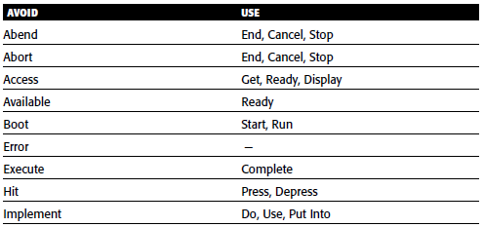
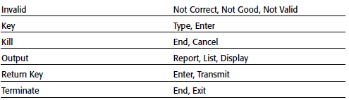
Some Words to Forget

Slide 13
Writing Sentences & Messages
Sentences and messages must be
Brief and simple.
Limited to no more than twenty words per sentence.
Limited to no more than six sentences per paragraph.
Written at an eighth grade level or less for the general population.
Directly and immediately usable.
An affirmative statement.
In an active voice.
In the temporal sequence of events
Structured so that the main topic is near the beginning
Of parallel construction

Slide 14
Writing Sentences & Messages
Sentences and messages must be of the proper tone:
Non authoritarian
Non threatening
Non anthropomorphic
Non patronizing
Non punishing
Cautious in the use of humor.

Slide 15
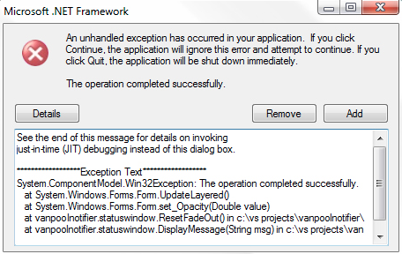
Kinds of Messages
Messages are communications provided on the screen to the screen viewer
Screen messages categories:
System Messages
generated by the system to keep the user informed of the system’s state and activities
They are customarily presented within message boxes
Instructional Messages
Sometimes referred to as prompting messages
Messages that tell the user how to work with, or complete, the screen displayed
They may be provided in messages boxes and also within the screen itself.

Slide 16
System Messages Types
Status—Provides information concerning the progress of a lengthy operation
Informational—Provides information about the state of the system when it is not immediately obvious
Warning—Calls attention to a situation that may be undesirable
Critical—Calls attention to conditions that require a user action before the system can proceed
Question—Asks a question and offers options

Slide 17
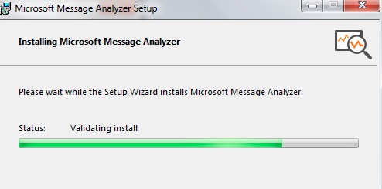
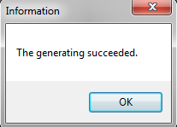
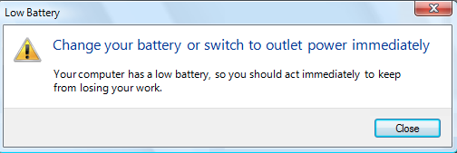
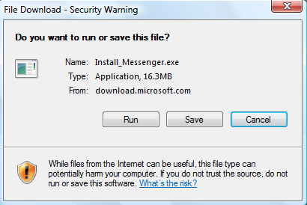
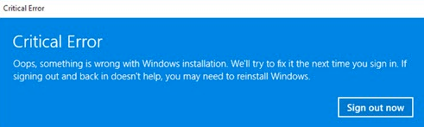

System Messages Example
Status
Warning
Critical
Informational
Question

Slide 18
Writing Message Box Text
Title bar:
Clearly identify the source of the message
The name of the object to which it refers
The name of the application to which it refers.
Do not include an indication of message type.
Use mixed case in the headline style.
Message box:
Provide a clear and concise description of the condition causing the message box to be displayed
Use complete sentences with ending punctuation
State the problem, its probable cause (if known), and what the user can do about it
Avoid contractions & technical jargon

Slide 19
Writing Message Box Text
Provide only as much background information as necessary for the message to be understood
Show only one message box about the cause of condition in a single message
Make the solution an option offered in the message
Avoid multistep solutions
Use consistent words and phrasing for similar situations
Use the word please conservatively
Do not exceed two or three lines
Include the relevant icon identifying the type of message to the left of the text
Center the message text in window

Slide 20
Message Box Controls
Command buttons:
If a message requires no choices to be made but only acknowledgment
Include an OK button
If a message requires a choice to be made, provide a command button for each option
Include OK and Cancel buttons only when the user has the option of continuing or stopping the action
Include Yes and No buttons when the user must decide how to continue
If these choices are too ambiguous, label the command buttons with the names of specific actions

Slide 21
Message Box Controls (cont'd)
If a message allows initiation of an action to correct the situation described,
Include a properly labeled button initiating the corrective action
If a message describes an interrupted process whose state cannot be restored,
Provide a Stop button.
If a message offers an opportunity to cancel a process as well as to perform or not perform an action
Provide a Cancel button
If more details about a message topic must be presented
Provide a Help button

Slide 22
Message Box Controls (cont'd)
Designate the most frequent or least destructive option as the default
Display a message box only when the window of an application is active
Display only one message box for a specific condition
Close box:
Enable the title bar Close box only if the message includes a Cancel button.

Slide 23
Message Location
Use the message line for messages that must not interfere with screen information
Pop-up windows may be used for all kinds of messages, if available
Pop-up windows should always be used for critical messages.

Slide 24
Instructional Messages
Provide instructional information at the depth of detail needed by the user
Locate it at strategic positions on the screen
Display it in a manner that visually differentiates it from other screen elements
In writing, follow all relevant writing guidelines for words, sentences, and messages

Slide 25
Presenting Text
Display prose text in mixed upper- and lower-case letters.
Fonts:
Use plain and simple fonts
Choose a minimum point size of 12 to 14.
Use proportional fonts
Justification:
Left-justify
Do not right-justify
Do not hyphenate words
Line Length:
If fast reading is required, use line lengths of about 75-100 characters

Slide 26
Presenting Text (Cont'd)
If user preference is important, a length of about 50-60 characters is acceptable
Very narrow columns should be avoided
Line endings:
Coincide with grammatical boundaries
Line spacing:
Increase line spacing to enhance legibility and readability
Content:
Use headings to introduce a new topic
Make first sentences descriptive Separate paragraphs by at least one blank line
Start a fresh topic on a new page
Use lists to present facts

Slide 27
Presenting Text (Cont'd)
Emphasize important things by
Positioning
Boxes
Bold typefaces
Indented margins
Provide a screen design philosophy consistent with other parts of the system

Slide 28
Writing Text
Sentences and paragraphs
Use short sentences
Cut the number of sentences
Style
Use the active writing style
Use subjective opinion
Use separate sentences for separate ideas
Keep the paragraphs short
Restrict a paragraph to only one idea
Use the personal writing style
Write as you talk
Use specific examples
Read it out loud

Slide 29
Window title, Conventions, & Sequence Control Guidance
Window Title
All windows must have a title located in a centered position at the top
Exception: Windows containing messages
Clearly and concisely describe the purpose of the window
Spell it out fully using an uppercase or mixed-case font.
If title truncation is necessary, truncate it from right to left.
If presented above a menu bar, display it with a background that contrasts with the bar

Slide 30
Window title, Conventions, & Sequence Control Guidance
Conventions
Establish conventions for referring to
Individual keyboard keys
Keys to be pressed at the same time
Field captions
Names supplied by users or defined by the system.
Commands and actions

Slide 31
Window title, Conventions, & Sequence Control Guidance
Sequence Control Guidance
Consider providing a guidance message telling how to continue at points in the dialog when
A decision must be made
A response needs to be made to continue
Consider indicating what control options exist at points in the dialog where several alternatives may be available
Permit these prompts to be turned on or off by the user

Slide 32
Presenting & Writing Page Text
The most important part of a Web site is its content, a well-written site is a necessity
Poorly written content has been found to increase user confusion, increase comprehension errors, increase reading times, and reduce user satisfaction
Content re-written properly for presentation on a Web site has been found to reduce the time to perform a task by 80 percent, improve one’s memory of the content by 100 percent, and increase user satisfaction by 37 percent (Morkes and Nielsen, 1998)

Slide 33
Words & Presentation of Page Text
Words
Minimize the use of words that call attention to the Web
Presentation
Provide text that contrasts highly with the background

Slide 34
Writing Page Text
Style:
Use a style reflecting the needs of the site users
Write objectively
Use the inverted pyramid organization
Be concise, using only about half the number of words of conventional text
Each paragraph should
Be short
Contain only one main idea
Links:
Minimize within-text links
Place them at the beginning or end of paragraphs or sections of text

Slide 35
Writing Page Text
Scanning:
Make text scannable by using
Bulleted listings
Tables
Headings and subheadings
Highlighted and emphasized important issues
Short paragraphs
International audience:
Consider internationalization needs
Testing:
Test for legibility and readability

Slide 36
Writing Link Labels
Create meaningful labels that use the following:
Descriptive, differentiable, predictive, and active wording
Keywords positioned at the beginning
Content that is concise but long enough to be understood
Wording that clearly indicates link destination or resulting action
Link names that match with their destination page
Integrate embedded links smoothly into the text
Ensure that embedded links are descriptive
Make only a few words the active link
Do not spread links over two lines
Standalone links should not exceed one sentence in length
Provide glosses or link labels to assist link understanding

Slide 37
Link Titles
Provide link titles that describe
The name of site the link will lead to (if different from current site).
The name of subsection the link will lead to (if staying within current site).
The kind of information to be found at the destination.
How the linked information relates to the anchor link and the current page content.
How large the linked information is.
Warnings about possible problems to be encountered at the other end.
Restrict titles to no more than 60 characters.

Slide 38
Page Title
Provide a page title
That possesses meaningful keywords
Whose first word is its most important descriptor
That makes sense when viewed completely out of context
That is different from other page titles
That is written in mixed case using the headline style
Do not highlight keywords

Slide 39
Headings and Headlines
Create meaningful headings and headlines that quickly communicate the content of what follows
Make the first word an important information-carrying one
Skip leading articles (the and a)
Create meaningful subheadings to break up large blocks of text

Slide 40
Instructions
Do not use phrasing that indicates a certain page order or flow
Explain where “Up” leads too
Phrase in a browser-independent manner
Minimize “Click here” instructions
Say “Select this link”

Slide 41
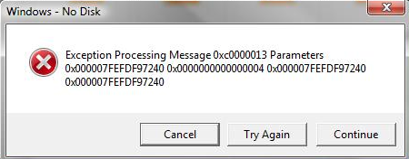
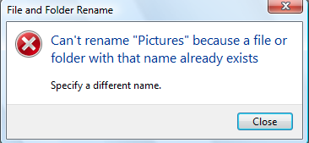
Error Messages
Provide helpful and precise error messages for
Incomplete or incorrectly keyed, entered, or selected data
Requests for documents that do not exist or cannot be found
Redisplay a message on the page to which it relates
Present them in a visually distinctive and noticeable manner

Slide 42
Contoh kasus penulisan teks

Slide 43
Instructional Messages

Slide 44
System Messages Example
Status
Warning
Critical
Informational
Question

Slide 45
Error Messages

Slide 46
Activities
Any text/messages/instructional/title/ etc… on your Project?
Review and revised your project based on the “Step 8” guideline!

Slide 47
Interaksi Manusia dan Komputer (IMK)
THE USER INTERFACE (UI) DESIGN PROCESS
Step - 9 Provide Effective Feedback and Guidance and Assistance

Slide 48
Tujuan
Setelah mengikuti materi ini mahasiswa dapat:
Mampu merancang feedback, guidance, dan assistance dengan efektif .

Slide 49
Provide Effective Feedback
feedback topics are discussed :
Acceptable response times.
Dealing with time delays.
Blinking for attention.
The use of sound.

Slide 50
Response times
The Fact Findings :
The optimum response time is dependent upon the task
Dissatisfaction with response time is a function of one’s uncertainty about delay
People will change work habits to conform to response time
Satisfaction with response time is a function of expectations
Constant delays are preferable to variable delays
Very fast or slow response times can lead to symptoms of stress

Slide 51
Web Page Download Times
Test participants rated the response times with the following results:
High (Good): Up to 5 seconds
Average: From 6 to 10 seconds
Low (Poor): Over 10 seconds
Other studies have found the following:
Longer delay times are tolerated by :
Novice users, Older users, People not experienced with high bandwidth connections, New visitors to a site, people performing important tasks, People performing successful tasks, Better content
Exceedingly slow sites can lead people to believe that they made an error

Slide 52
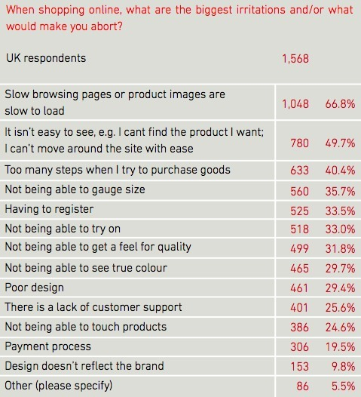
Fun Fact
http://brandperfect.org/

Slide 53
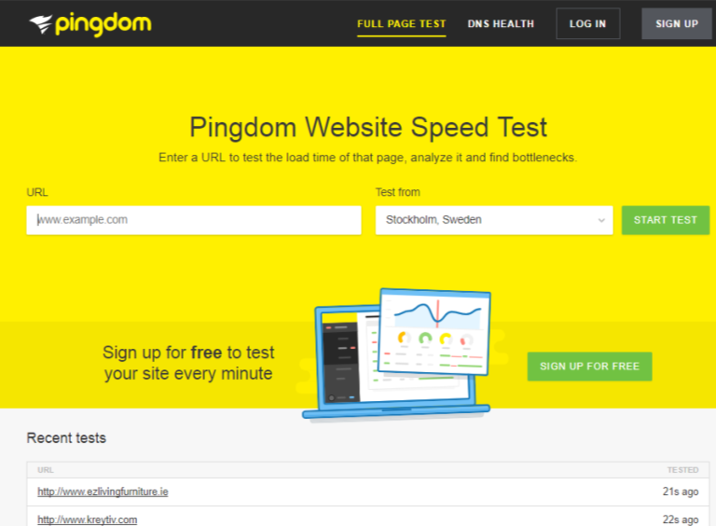
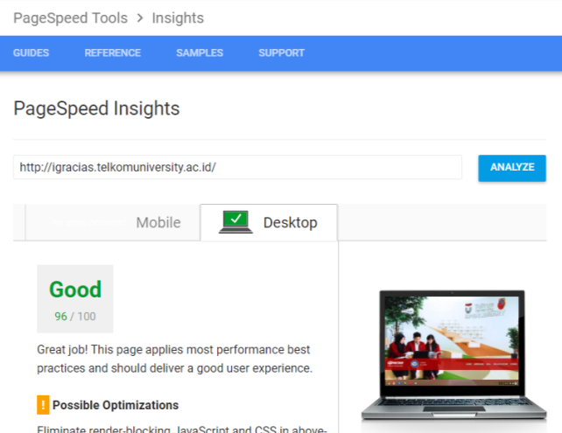
Tools for Measurement

Slide 54
Web Page Download Times
Guideline:
Maximum downloading time should be about 10 seconds.
Use incremental or progressive image presentation.
Images should be
Small
Lean (Low bit depth, resolution, use of fewer colors, and so forth).
Reusable.
Contain pixel height and width dimensions in a tag.
Use thumbnail images to preview larger images.
Use simple background images

Slide 55
Dealing with Time Delays
Button click acknowledgement:
Acknowledge all button clicks by visual or aural feedback within one-tenth of a second.
Waits of up to 10 seconds:
If an operation takes 10 seconds or less to complete, present a “busy” signal until the operation is complete.
Display, for example, an animated hourglass pointer.
Waits of 10 seconds to 1 minute:
If an operation takes longer than 10 seconds to complete, display
A rolling barber’s pole or other large animated object.
Additionally, a progress indicator, percent complete message, or elapsed time message.

Slide 56
Dealing with Time Delays
Waits over 1 minute:
Present an estimate of the length of the wait.
Display a progress indicator, percent complete message, or elapsed time message.
Long, invisible operations:
When an operation not visible to the user is completed, present an acknowledgement that it is completed.
A message Or An auditory tone.
Progress indicator:
Along rectangular bar that is initially empty but filled as the operation proceeds.
Dynamically fill the bar.
Fill it with a color or shade of gray.
Fill it from left to right or bottom to top

Slide 57
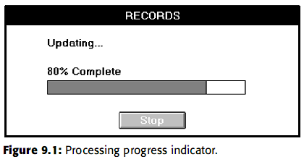
Dealing with Time Delays
Percent complete message: Useful if a progress indicator takes too long to update
Elapsed time message: A message that shows the amount of elapsed time
Web page downloads

Slide 58
Blinking for Attention
Attract attention by flashing an indicator when an application is inactive but must display a message to the user.
To provide an additional message indication, also provide an auditory signal (one or two beeps).
Display the message

Slide 59

Use of Sound
Always use in conjunction with a visual indication.
Use no more than six different tones.
Do not use : Jingles or tunes or Loud signals.
Use tones consistently.
Provide signal frequencies between 500 and 1,000 Hz.
Allow the user to adjust the volume or turn the sound off altogether.
Test the sounds with users over extended trial periods.
Use sounds sparingly

Slide 60
Contoh studi kasus feedback

Slide 61
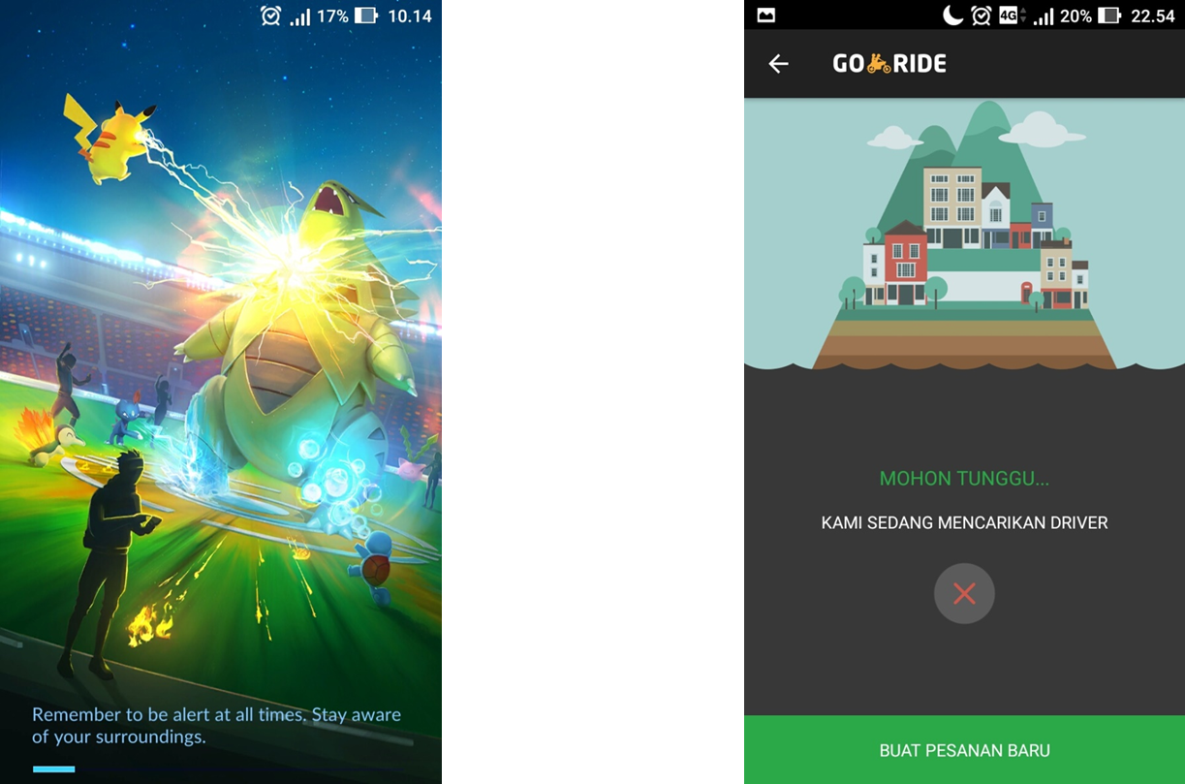

Slide 62
Guidance and Assistance

Slide 63
Guidance and Assistance
Preventing Error
Error
Slip
Mistakes
automatic behavior
gone awry
results from forming
a wrong model or
goal and
then acting on it
Everyone makes mistakes, so every mistake should be fixable

Slide 64
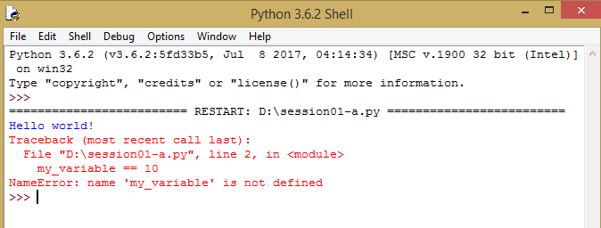

Penyebab eror difokuskan
Koreksi dan rekomendasi terhadap salah ketik oleh pengguna

Slide 65
Problem Management
Prevention
Disable inapplicable choices.
For conversational dialogs, validate entries as close to point of entry as possible
Correction
Preserve as much of the user’s work as possible.
Always give a person something to do when an error occurs
Use selection instead of entry controls.
Accept common misspellings, whenever possible
Use aided entry.
Detection
At character level.
At control level.
When the transaction is completed or the window closed.
Do not obscure item in error.
At window-level validation, use a modeless dialog box to display an error list.

Slide 66
Providing Guidance and Assistance
Guidance can describe in
the form of the system’s hard copy,
online documentation,
computer-based training,
instructional or prompting messages, and
system messages,
Useful guidance and assistance answers the following questions:
What is this?
What does it do?
How do I make it do it?
What is its role in the overall scheme of things?

Slide 67
Problems with Documentation
factors contribute to bad design
Time scale
Organizational factors
Theoretical rationale.
Resources

Slide 68
How Users Interact with Documentation
three broad stages through which a reader interacts with documentation :
finding information that is relevant
understanding what the documentation says
applying that understanding to the current task to solve the problem

Slide 69
How Users Interact with Documentation
principles :
Help Facility
Instructions or Prompting
Contextual Help
Task-Oriented Help
Reference Help
Hints or Tips
Wizards

Slide 70
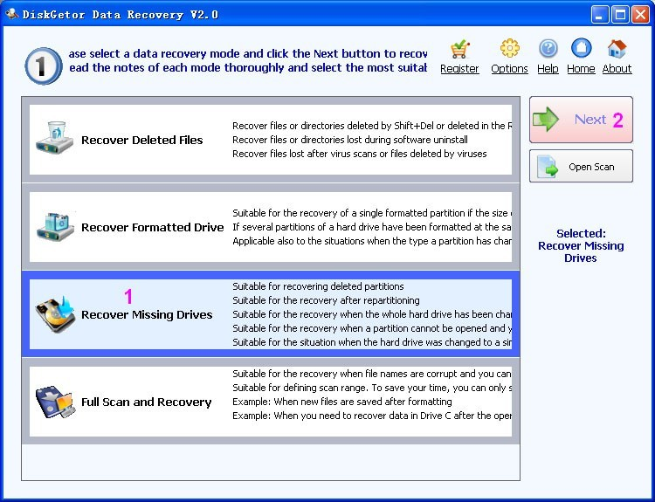
Instructions or Prompting
placed within the body of a screen
Prompting is provided to assist a person in providing what is necessary to complete a screen
Guidelines for writing instructions and prompts are covered in Step 8.

Slide 71

Help Facility
Help Facility Guidelines
Kind:
Training:
Availability:
Structure:
Interaction:
Location:
Content:
Style:
Consistency:
Title:

Slide 72

Contextual Help
Provides information within the context of a task being performed
Help Command Button
■ Description:
— A command button.
■ Purpose:
— To provide an overview of, summary assistance for, or explanatory information about the purpose or contents of a window being displayed.
■ Design guidelines:
–– Present Help in a secondary window or dialog box.

Slide 73

Contextual Help
Status Bar Message
Description:
An abbreviated, context-sensitive message related to the screen item with the focus.
Appears in window’s status bar when the primary mouse button is pressed over an item (or keyboard focus is achieved).
Purpose:
To provide explanatory information about the object with the focus.

Slide 74

Contextual Help
ToolTip
Description:
A small pop-up window that appears adjacent to control.
Presented when the pointer remains over a control a short period of time.
Purpose:
Use to display the name of a control when the control has no text label.
Design guidelines:
Make application-specific ToolTips consistent with system-supplied ToolTips.
Use system color setting for ToolTips above to distinguish them.

Slide 75
Contextual Help
What’s This? Command
Description:
A command located on the Help drop-down menu on a primary window.
A button on the title bar of a secondary window.
A command on a pop-up menu for a specific object.
A button on a toolbar.
Purpose:
Use to provide contextual information about any screen object.
Design guidelines:
Phrase to answer the question “What is this?”
Indicate the action associated with the item.
Begin the description with a verb.

Slide 76
Task-Oriented Help
Description:
A primary window typically accessed through the Help Topics browser.
Includes a set of command buttons at the top; Purpose:
To describe the procedural steps for carrying out a task.
Focuses on how to do something.
Design guidelines:
Provide one procedure to complete a task, the simplest and most common.
Provide an explanation of the task’s goals and organizational structure at the start.
Divide procedural instructions into small steps.
Present each step in the order to be executed.

Slide 77
Reference Help
Description:
An online reference book.
Typically accessed through a
Command in a Help drop-down menu.
Toolbar button.
Purpose:
To present reference Help information, either
Design guidelines:
Provide a consistent presentation style, following all previously presented guidelines.
Include a combination of contextual Help, and task-oriented Help, as necessary.
Include text, graphics, animation, video, and audio effects,

Slide 78
Wizards
Description:
A series of presentation pages displayed in a secondary window. — Include : Controls to collect input, Navigation command buttons.
Typically accessed through
Purpose:
To perform a complex series of steps.
To perform a task that requires making several critical decisions.
To enter critical data and for use when the cost of errors is high.
To perform an infrequently accomplished task.

Slide 79
Hints or Tips
Description:
A command button labeled Hints or Tips.
Purpose:
To provide a few important contextual, but specific, items of information related to a displayed screen
Design guidelines:
Provide guidance on only two or three important points.
Locate the button near where its guidance applies.
Write concisely and to the point

Slide 80
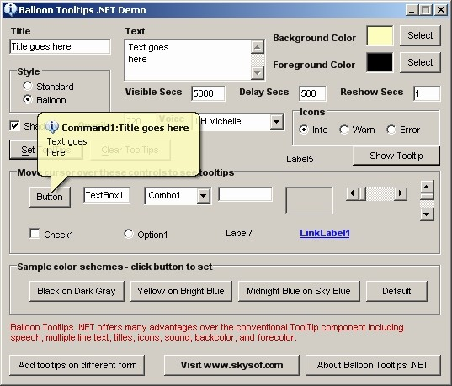
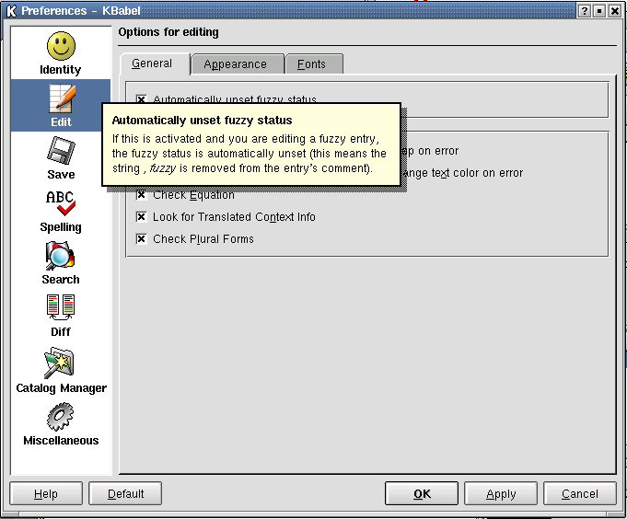
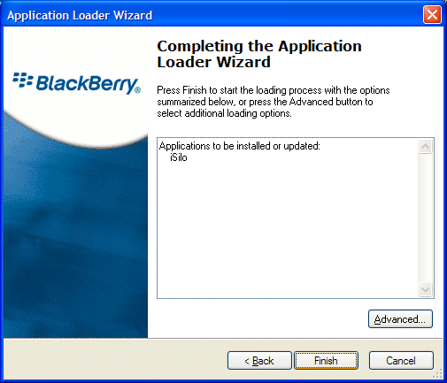
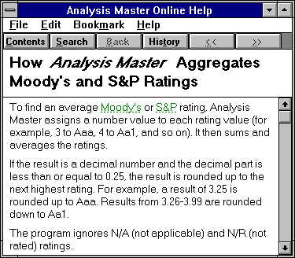

Slide 81
Contoh studi kasus Guidances & Assistance

Slide 82
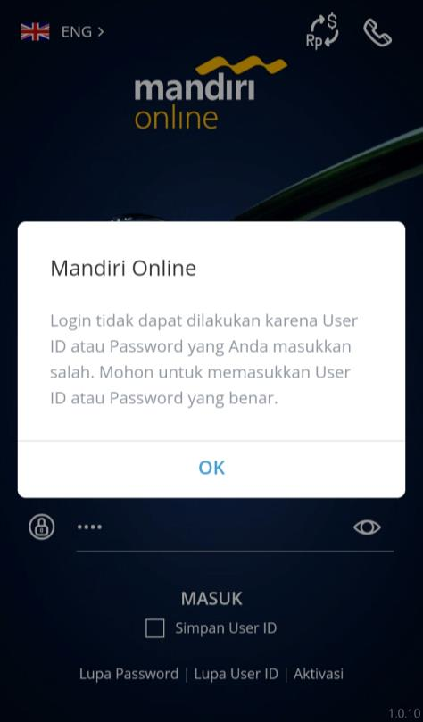
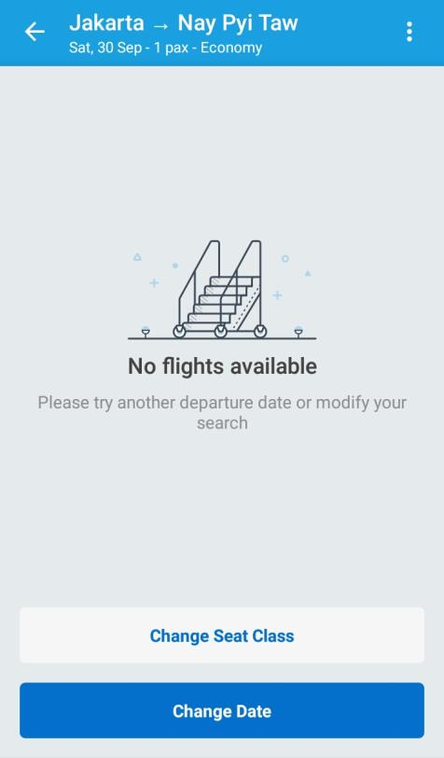
Eror karena kesalahan pengguna
Hasil operasi tidak memenuhi ekspektasi

Slide 83
Activity
Review carefully you project,
Is there any feedback, guidance and assistance?

Slide 84
Project Progress Presentation 1
Prepare Your Paper prototype
Prepare Your storyboard
Prepare You Report
See U in Presentation ☺

